Slide 1
Classical Encryption Techniques
By
Dr. Zia ur rehman

Slide 2
One-Time Pad
Joseph Mauborgne, proposed an improvement to the Vernam cipher that yields the ultimate in security. He suggested using a random key that is as long as the message, so that the key need not be repeated.
The key is to be used to encrypt and decrypt a single message, and then is discarded. Each new message requires a new key of the same length as the new message. Such a scheme, known as a one-time pad.
It produces random output that bears no statistical relationship to the plaintext.
The cipertext contains no information whatsoever about the plaintext, there is simply no way to break the code

Slide 3
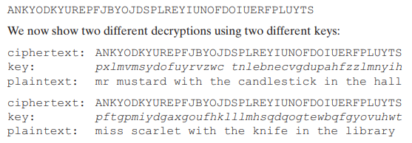
One-Time Pad
Consider the following ciphertext
Notes:
More keys more possibilities which one is correct?
if you did an exhaustive search of all possible keys, you would end up with many legible plaintexts, with no way of knowing which was the intended plaintext
The security of the one-time pad is entirely due to the randomness of the key.

Slide 4
One-Time Pad – fundamental deficulties
There is the practical problem of making large quantities of random keys. Any heavily used system might require millions of random characters on a regular basis. Supplying truly random characters in this volume is a significant task.
Even more daunting is the problem of key distribution and protection. For every message to be sent, a key of equal length is needed by both sender and receiver. Thus, a mammoth key distribution problem exists.
Notes:
the one-time pad is of limited utility and is useful primarily for low-bandwidth channels requiring very high security.
The one-time pad is the only cryptosystem that exhibits what is referred to as perfect secrecy.

Slide 5

Transposition cipher
A very different kind of mapping is achieved by performing some sort of permutation on the plaintext letters. This technique is referred to as a transposition cipher.
The example of such cipher is Rail Fence cipher, e.g.
to encipher the message “meet me after the toga party” with a rail fence of depth 2, we write the following:
The encrypted form
MEMATRHTGPRYETEFETEOAAT

Slide 6
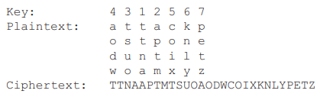
Transposition cipher
A more complex scheme is to write the message in a rectangle, row by row, and read the message off, column by column, but permute the order of the columns.
The transposition cipher can be made significantly more secure by performing more than one stage of transposition.
Notes:
Digram and trigram frequency tables can be useful

Slide 7
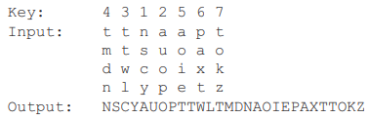

Transposition cipher
Lets re-transpose the ciphertext:
To visualize properly, designate the letters in the original plaintext message by the numbers designating their position.

Slide 8


Transposition cipher
After 1st transposition:
After 2nd transposition:
This is a much less structured permutation and is much more difficult to cryptanalyze.

Slide 9
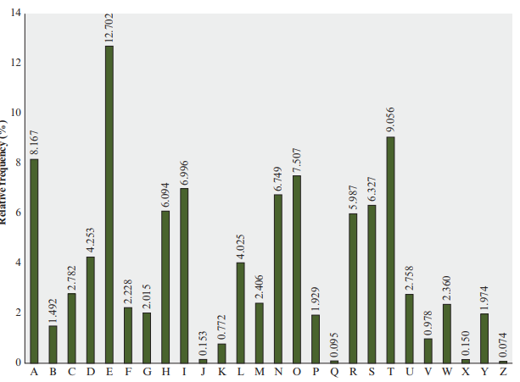
wzsxz gqv zqhhnf ol ozn glco zlfnco hnlhrn; nsoznj

Slide 10
Product ciphers
Ciphers using substitutions or transpositions are not secure because of language characteristics.
• hence consider using several ciphers in succession to make harder,
but:
two substitutions make a more complex substitution
two transpositions make more complex transposition
but a substitution followed by a transposition makes a new much harder cipher
this is bridge from classical to modern ciphers

Slide 11
Rotor ciphers
before modern ciphers, rotor machines were most common complex ciphers in use
Widely used in WW2
German Enigma, Allied Hagelin, Japanese Purple
Implemented a very complex, varying substitution cipher
used a series of cylinders, each giving one substitution, which rotated and changed after each letter was encrypted
with 3 cylinders have 26³=17576 alphabets

Slide 12
Overview of Data encryption standard (des) algo
DES was issued in 1977 by the National Bureau of Standards, now the National Institute of Standards and Technology (NIST), as Federal Information Processing Standard 46 (FIPS PUB 46).
The algorithm itself is referred to as the Data Encryption Algorithm (DEA).6 For DEA, data are encrypted in 64-bit blocks using a 56-bit key.
Subsequently Advanced Encryption Algorithm (AES) replaced it in 2001.

Slide 13
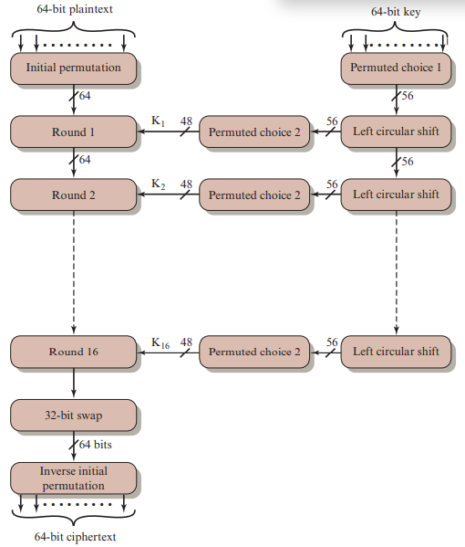
Des algo

Slide 14
AES algorithm
AES is a symmetric block cipher that is intended to replace DES as the approved standard for a wide range of applications.
It is most widely used algorithm.
FINITE FIELD ARITHMETIC
In AES, all operations are performed on 8-bit bytes. In particular, the arithmetic operations of addition, multiplication, and division are performed over the finite field.
An example of a finite field (one with a finite number of elements) is the set Zp consisting of all the integers {0, 1, …. , p - 1}, where p is a prime number and in which arithmetic is carried out modulo p.
Notes:
a field is a set in which we can do addition, subtraction, multiplication, and division without leaving the set.
Division is defined with the following rule: a/b = a(b-1 ).

Slide 15
AES algorithm
The cipher takes a plaintext block size of 128 bits, or 16 bytes
The key length can be 16, 24, or 32 bytes (128, 192, or 256 bits). The algorithm is referred to as AES-128, AES-192, or AES-256, depending on the key length.
The input to the encryption and decryption algorithms is a single 128-bit block.
this block is depicted as a 4 * 4 square matrix of bytes.
block is copied into the State array, which is modified at each stage of encryption or decryption. After the final stage, State is copied to an output matrix.
Notes:
a field is a set in which we can do addition, subtraction, multiplication, and division without leaving the set.
Division is defined with the following rule: a/b = a(b-1 ).
Vulnerabilities

Slide 16
Aes algorithm
the key is depicted as a square matrix of bytes. This key is then expanded into an array of key schedule words.
the first four bytes of the expanded key, which form a word, occupy the first column of the w matrix.
The cipher consists of N rounds, where the number of rounds depends on the key length: 10 rounds for a 16-byte key, 12 rounds for a 24-byte key, and 14 rounds for a 32-byte key
Notes:
Each word is four bytes, and the total key schedule is 44 words for the 128-bit key.
Note that the ordering of bytes within a matrix is by column.

Slide 17
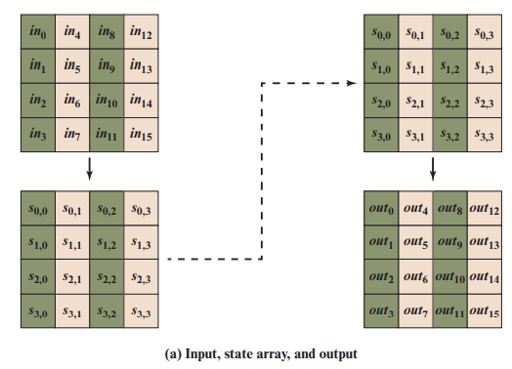
Aes algorithm
Notes:
Each word is four bytes, and the total key schedule is 44 words for the 128-bit key.
Note that the ordering of bytes within a matrix is by column.

Slide 18
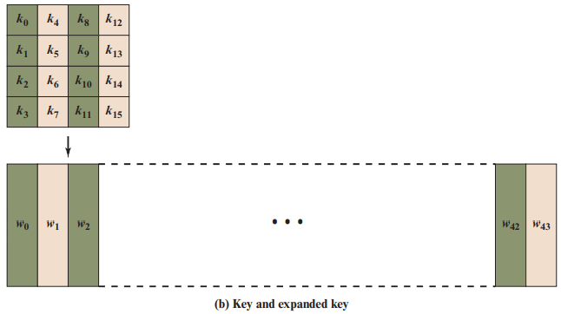
Aes algorithm
Notes:
Each word is four bytes, and the total key schedule is 44 words for the 128-bit key.
Note that the ordering of bytes within a matrix is by column.

Slide 19
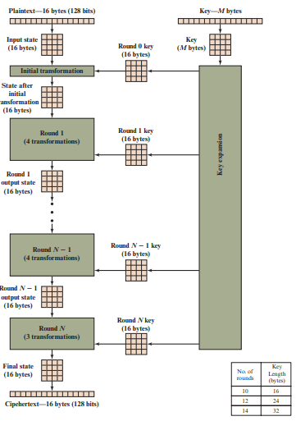
Aes structure
Notes:
transformation functions: SubBytes, ShiftRows, MixColumns, and AddRoundKey,
The final round contains only three transformations, and there is a initial single transformation (AddRoundKey) before the first round, which can be considered Round 0.

Slide 20
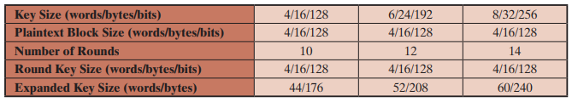
Aes parameters
Notes:
The cipher consists of N rounds, where the number of rounds depends on the key length: 10 rounds for a 16-byte key, 12 rounds for a 24-byte key, and 14 rounds for a 32-byte key.

Slide 21
Aes transformation functions
Substitute bytes: Uses an S-box to perform a byte-by-byte substitution of the block.
ShiftRows: A simple permutation.
MixColumns: A substitution that makes use of arithmetic over GF(2⁸ ).
AddRoundKey: A simple bitwise XOR of the current block with a portion of the expanded key.

Slide 22
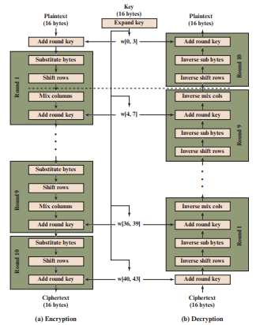
Aes encryption and decryption

Slide 23
Substitute Bytes Transformation
Forward and Inverse Transformations: The forward substitute byte transformation, called SubBytes, is a simple table lookup.
AES defines a 16 * 16 matrix of byte values, called an S-box that contains a permutation of all possible 256 8-bit values.
Each individual byte of State is mapped into a new byte in the following way:
The leftmost 4 bits of the byte are used as a row value and the rightmost 4 bits are used as a column value.
These row and column values serve as indexes into the S-box to select a unique 8-bit output value

Slide 24
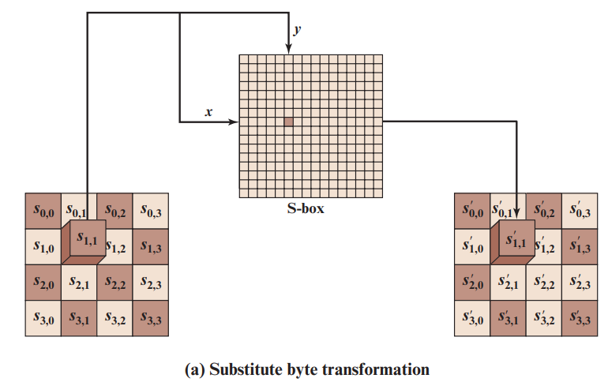
Substitute Bytes Transformation

Slide 25
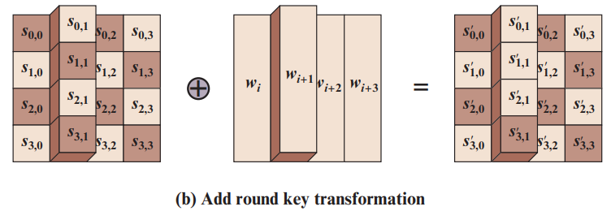
Add round transformation

Slide 26
AES – Mix column Transformation
2 | 3 | 1 | 1
1 | 2 | 3 | 1
1 | 1 | 2 | 3
3 | 1 | 1 | 2
87 | F2 | 4D | 97
6E | 4C | 90 | EC
46 | E7 | 4A | C3
A6 | 8C | D8 | 95
47
37
94
?
*
=

